Slide 1
Module 4
Predicting Diseases

Slide 2
Outline
Introduction to module
Classification and prediction methods
Overview of classification and prediction methods
Classification methods based on analogy
Classification methods based on neural networks
Classification methods based on rules
Classification methods based on probabilities
Classification methods based on statistics
Prediction methods
Evaluation of prediction performance
Evaluation schemes
Combining feature selection and prediction
Prediction workflow
Classification and prediction with R
R scripts for prediction from gene expressions

Slide 3
Learning Objectives
1. Build classification and prediction models.
2. Evaluate the performance of classification and prediction methods.
3. Write R scripts to classify and predict diseases from gene expressions.

Slide 4
Introduction to Module
This module studies how we make predictions based on Big Data, which often involves mixed data such as clinical data and genetic data.
One generally differentiates between classification and prediction tasks, however both aim at predicting a particular variable, whether it is a disease, the severity of a disease, or the survival length.
Since there are many methods available for prediction tasks, it is important to well evaluate and compare their performance.
Here also, overfitting is to watch for.
R provides many useful functions for prediction tasks.

Slide 5
Outline
Introduction to module
Classification and prediction methods
Overview of classification and prediction methods
Classification methods based on analogy
Classification methods based on neural networks
Classification methods based on rules
Classification methods based on probabilities
Classification methods based on statistics
Prediction methods
Evaluation of prediction performance
Evaluation schemes
Combining feature selection and prediction
Prediction workflow
Classification and prediction with R
R scripts for prediction from gene expressions

Slide 6
Classification and Prediction Methods
Data analytics is actually a process involving several steps:
Application domain understanding.
Data understanding.
Data preprocessing.
Model building.
Training and evaluation.
Deployment.
At this stage, we are going to build models for prediction tasks.

Slide 7
Outline
Introduction to module
Classification and prediction methods
Overview of classification and prediction methods
Classification methods based on analogy
Classification methods based on neural networks
Classification methods based on rules
Classification methods based on probabilities
Classification methods based on statistics
Prediction methods
Evaluation of prediction performance
Evaluation schemes
Combining feature selection and prediction
Prediction workflow
Classification and prediction with R
R scripts for prediction from gene expressions

Slide 8
Overview of Classification and Prediction Methods
Classification and prediction are the most frequently used tasks in data analytics.
Methods to achieve this task are varied and span many disciplines, the most well known being machine learning and statistics.
Classification predicts a categorical valued class. Prediction predicts a numerical valued feature.

Slide 9
Overview of Classification and Prediction Methods
Classification and prediction tasks aim at building models that describe and distinguish classes or concept for future prediction.
Ex: Diagnosing a disease is a typical classification task. Evaluating the risk or severity of a disease in a patient is a typical prediction task.
What differentiates between the methods is the type of algorithm or process used to build the predictive models from data – whether it is based on analogies, rules, neural networks, probabilities, or statistics.

Slide 10
Overview of Classification and Prediction Methods
This model building involves using a dataset for training, then another one for testing.
Often, there is only one dataset to work from, and there are several strategies to create the training / testing framework.
The end goal is to put the model in production, which is when it will be applied to any new data – a new patient coming for a visit, or online.

Slide 11
Outline
Introduction to module
Classification and prediction methods
Overview of classification and prediction methods
Classification methods based on analogy
Classification methods based on neural networks
Classification methods based on rules
Classification methods based on probabilities
Classification methods based on statistics
Prediction methods
Evaluation of prediction performance
Evaluation schemes
Combining feature selection and prediction
Prediction workflow
Classification and prediction with R
R scripts for prediction from gene expressions

Slide 12
Classification Methods Based on Analogy
Two main classification methods are based on analogy:
The support vector machine (SVM).
Nearest-neighbor classifier (kNN).

Slide 13
Classification Methods Based on Analogy
Goal of SVM: to generate mathematical functions that map input variables to desired outputs for classification or regression type prediction problems.
First, SVM uses nonlinear kernel functions to transform non-linear relationships among the variables into linearly separable feature spaces.
Then, the maximum-margin hyperplanes are constructed to optimally separate different classes from each other based on the training dataset.
SVM has solid mathematical foundation!

Slide 14
Classification Methods Based on Analogy
A hyperplane is a geometric concept used to describe the separation surface between different classes of things.
In SVM, two parallel hyperplanes are constructed on each side of the separation space with the aim of maximizing the distance between them.
A kernel function in SVM uses the kernel trick (a method for using a linear classifier algorithm to solve a nonlinear problem)
The most commonly used kernel function is the radial basis function (RBF).

Slide 15
Classification Methods Based on Analogy
Many linear classifiers (hyperplanes) may separate the data

Slide 16
Classification Methods Based on Analogy
SVMs are the most widely used kernel-learning algorithms for wide range of classification and regression problems.
SVMs represent the state-of-the-art by virtue of their excellent generalization performance, superior prediction power, ease of use, and rigorous theoretical foundation.
Most comparative studies show its superiority in both regression and classification type prediction problems.

Slide 17
Classification Methods Based on Analogy
SVMs → time-demanding, computationally intensive iterative derivations
k-NN is a simplistic and logical prediction method, that produces very competitive results – in particular for Big Data
k-NN is a prediction method for classification as well as regression types (similar to SVM)
k-NN is a type of instance-based learning (or lazy learning) – most of the work takes place at the time of prediction (not at modeling)
k : the number of neighbors used
Data are kept after modeling (not only the model).

Slide 18
Classification Methods Based on Analogy
How many neighbors ?
The answer depends on the value of k.
Which distance measure ?
It depends on the data –
Euclidian distance or more complex.

Slide 19
Classification Methods Based on Analogy

Slide 20

Classification Methods Based on Analogy
Antal van den Bosch

Slide 21
Outline
Introduction to module
Classification and prediction methods
Overview of classification and prediction methods
Classification methods based on analogy
Classification methods based on neural networks
Classification methods based on rules
Classification methods based on probabilities
Classification methods based on statistics
Prediction methods
Evaluation of prediction performance
Evaluation schemes
Combining feature selection and prediction
Prediction workflow
Classification and prediction with R
R scripts for prediction from gene expressions

Slide 22
Classification Methods Based on Neural Networks
Neural networks (NN): a brain metaphor for information processing
Neural computing
Artificial neural network (ANN)
Many uses for ANN for
pattern recognition, forecasting, prediction, and classification.

Slide 23
Classification Methods Based on Neural Networks
A single neuron (processing element – PE) with inputs and outputs

Slide 24
Classification Methods Based on Neural Networks
Architecture of a neural network is driven by the task it is intended to address
Classification, regression, clustering, general optimization, association, ….
Most popular architecture: Feedforward, multi-layered perceptron with backpropagation learning algorithm
Used for both classification and regression type problems
Others – Recurrent, self-organizing feature maps, Hopfield networks, …

Slide 25
Classification Methods Based on Neural Networks
Feed-forward MLP with 1 Hidden Layer

Slide 26
Classification Methods Based on Neural Networks
Neural networks learn the prediction model, which is here a set of weights representing the underlying relationship between inputs and outputs, or just among the inputs.
Once trained, the neural network stops learning and can be applied to new data for classification or prediction tasks.
Deep learning is based on advanced neural networks.
They provide excellent pattern recognition performance and are one of the major methods used in machine learning.
Neural networks require important computing power, have a set of parameters to adjust, and are often not much understandable.

Slide 27
Outline
Introduction to module
Classification and prediction methods
Overview of classification and prediction methods
Classification methods based on analogy
Classification methods based on neural networks
Classification methods based on rules
Classification methods based on probabilities
Classification methods based on statistics
Prediction methods
Evaluation of prediction performance
Evaluation schemes
Combining feature selection and prediction
Prediction workflow
Classification and prediction with R
R scripts for prediction from gene expressions

Slide 28
Classification Methods Based on rules
Decision tree method:
Employs the divide and conquer method
Recursively divides a training set until each division consists of examples from one class
Create a root node and assign all of the training data to it
Select the best splitting attribute
Add a branch to the root node for each value of the split. Split the data into mutually exclusive subsets along the lines of the specific split
Repeat the steps 2 and 3 for each and every leaf node until the stopping criteria is reached.
A general algorithm for decision tree building

Slide 29
Classification Methods Based on rules
Decision tree algorithms mainly differ on
Splitting criteria
Which variable to split first?
What values to use to split?
How many splits to form for each node?
Stopping criteria
When to stop building the tree
Pruning (generalization method)
Pre-pruning versus post-pruning
Most popular decision tree algorithms include
ID3, C4.5, C5; CART; CHAID; M5

Slide 30
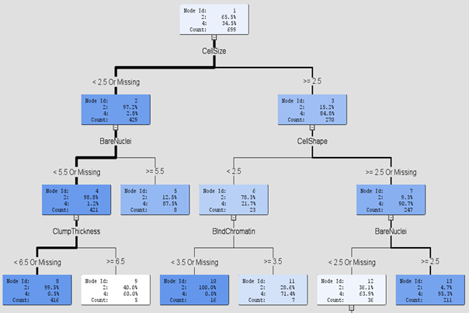
Classification Methods Based on rules
Decision tree building process is very efficient for Big Data, and has the advantage of being easily understandable.
For example, on this tree to classify sample between two classes 2 and 4, samples with Cellsize < 2.5 AND BareNuclei < 5.5 AND ClumpThickness < 6.5 belong to class 2 in 99.5% of the cases.

Slide 31
Outline
Introduction to module
Classification and prediction methods
Overview of classification and prediction methods
Classification methods based on analogy
Classification methods based on neural networks
Classification methods based on rules
Classification methods based on probabilities
Classification methods based on statistics
Prediction methods
Evaluation of prediction performance
Evaluation schemes
Combining feature selection and prediction
Prediction workflow
Classification and prediction with R
R scripts for prediction from gene expressions

Slide 32
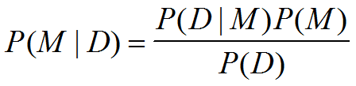
Classification Methods Based on Probabilities
Bayesian networks, also called belief networks or graphical models, derive a predictive model from data based on Bayes theorem: where M is a model (hypotheses), D are the data
P(M|D) is the posterior - updated belief that M is correct
P(M) is our estimate that M is correct prior to any data
P(D|M) is the likelihood.

Slide 33
Classification Methods Based on Probabilities
To be able to infer a model, the model needs to evaluate:
The prior P(M)
The likelihood P(D/M).
They allow to model situations in a probabilistic network but also to reason from the network – also called to perform inferences.
Causal relationships are made explicit and can be used to propagate new facts or beliefs into the network.

Slide 34
Classification Methods Based on Probabilities
Family
History
Smoker
(FH, S)
(FH, ~S)
(~FH, S)
(~FH, ~S)
LC
0.8
0.5
0.7
0.1
LungCancer
Emphysema
~LC
0.2
0.5
0.3
0.9
The conditional probability table for the variable LungCancer
PositiveXRay
Dyspnea
Bayesian Belief Networks

Slide 35
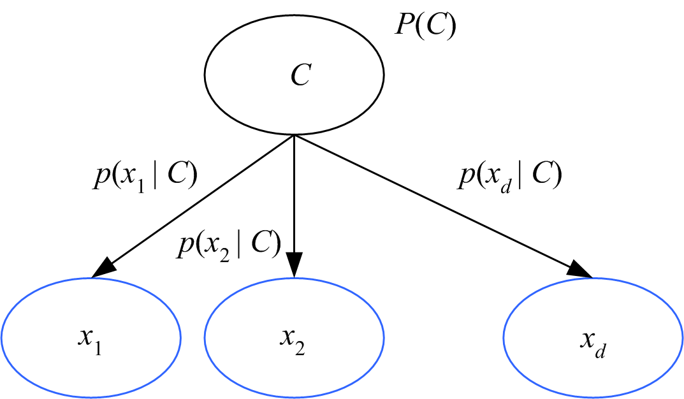
Classification Methods Based on Probabilities
They are very important in biomedicine because they can calculate a probability associated with a diagnosis (or classification), for example in differential diagnosis.
Graphical representations are highly valued for understandability – like in decision trees.
There is a simplified version of this method called Naïve Bayes.
These methods are based on the hypothesis of independence between features, which may require feature selection before the prediction task.

Slide 36
Outline
Introduction to module
Classification and prediction methods
Overview of classification and prediction methods
Classification methods based on analogy
Classification methods based on neural networks
Classification methods based on rules
Classification methods based on probabilities
Classification methods based on statistics
Prediction methods
Evaluation of prediction performance
Evaluation schemes
Combining feature selection and prediction
Prediction workflow
Classification and prediction with R
R scripts for prediction from gene expressions

Slide 37
Classification Methods Based on Statistics
Statistics provides many useful models for classification and prediction, among which are:
Regression models to predict a numeric feature.
Logistic regression models to predict a categorical feature (or class).
Generalized linear models (GLM) to predict a numeric or categorical feature with more flexibility of data distribution shape (does not need to be normal like in standard linear regression).
They often require particular conditions to be used, such as a normal distribution, or independent features, which are often not completely met with Big Data.

Slide 38
Classification Methods Based on Statistics
Statistical models like GLM do provide though some functions that others do not, for example the ability to consider confounding factors – or factors that may influence the classification and that we would like to isolate from the other features under consideration.
Ex: age, gender, body mass index, socio-economic status.

Slide 39
Classification Methods Based on Statistics
y
Linear regression for prediction: If X is fever, Y may calculate the severity of the flu.
Linear regression learns weights associated with the features and a probability as to whether this feature is significantly important for the target feature (the one we want to calculate).
Y1
Y1’
y = x + 1
X1
x

Slide 40
Outline
Introduction to module
Classification and prediction methods
Overview of classification and prediction methods
Classification methods based on analogy
Classification methods based on neural networks
Classification methods based on rules
Classification methods based on probabilities
Classification methods based on statistics
Prediction methods
Evaluation of prediction performance
Evaluation schemes
Combining feature selection and prediction
Prediction workflow
Classification and prediction with R
R scripts for prediction from gene expressions

Slide 41
Prediction Methods
Prediction methods predict the value of a numeric, continuous variable (Ex: predict a severity risk index, or survival length):
Regression
Neural networks
SVMs
kNN
etc.

Slide 42
Prediction Methods
Prediction is more complex than classification due to the large number of possible outcomes to predict.
It is often preferable to discretize the target feature (the one we want to predict) for better performance results.
Ex: to predict a risk index, one can decide to classify into three categories: low risk, medium risk, high risk.

Slide 43
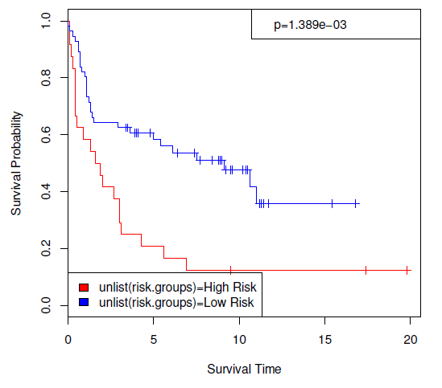
Prediction Methods
Survival analysis example (Annest et al. 2009) regression with Kaplan Meier survival (in years) curve showing the survival difference between two groups of patients: high-risk and low-risk.

Slide 44
Outline
Introduction to module
Classification and prediction methods
Overview of classification and prediction methods
Classification methods based on analogy
Classification methods based on neural networks
Classification methods based on rules
Classification methods based on probabilities
Classification methods based on statistics
Prediction methods
Evaluation of prediction performance
Evaluation schemes
Combining feature selection and prediction
Prediction workflow
Classification and prediction with R
R scripts for prediction from gene expressions

Slide 45
Evaluation of Prediction Performance
In order to evaluate a model’s performance, specific measures have been designed.
They also afford for the comparison between different models.
The most important are accuracy, area under ROC curve, sensitivity, specificity, and error.

Slide 46
Outline
Introduction to module
Classification and prediction methods
Overview of classification and prediction methods
Classification methods based on analogy
Classification methods based on neural networks
Classification methods based on rules
Classification methods based on probabilities
Classification methods based on statistics
Prediction methods
Evaluation of prediction performance
Evaluation schemes
Combining feature selection and prediction
Prediction workflow
Classification and prediction with R
R scripts for prediction from gene expressions

Slide 47
Evaluation Schemes
Evaluation of classifiers
Predictive accuracy
Hit rate
Area under ROC curve
Speed
Model building; predicting
Robustness
Scalability
Interpretability
Transparency, explainability.

Slide 48
Evaluation Schemes
In classification problems, the primary source for accuracy estimation is the confusion matrix

Slide 49
Evaluation Schemes
Independent training and test sets (preferred).
k-Fold Cross Validation (rotation estimation)
Split the data into k mutually exclusive subsets
Use each subset as testing while using the rest of the subsets as training
Repeat the experimentation for k times
Aggregate the test results for true estimation of prediction accuracy training.
Simple split (or holdout or test sample estimation)
Split the data into 2 mutually exclusive sets training (~70%) and testing (30%)
For neural networks, the data is split into three sub-sets (training [~60%], validation [~20%], testing [~20%])
Other estimation methodologies
Leave-one-out, bootstrapping, jackknifing
Area under the ROC curve.

Slide 50
Evaluation Schemes
Prediction method (algorithm) | #errors Leukemia2 (/34) | # errors Leukemia3 (/34) | Average accuracy
BMA+KNN BMA+DT BMA+LR BMA+NB BMA+NN BMA+SVM BSS/WSS +KNN BSS/WSS +DT BSS/WSS +LR BSS/WSS +NB BSS/WSS +NN BSS/WSS +SVM | 1 3 1 4 1 1 1 3 2 3 2 0 | 1 5 4 3 2 2 1 3 4 5 1 1 | 97% 88% 93% 89% 96% 96% 97% 91% 91% 88% 96% 99%
The classifier with least number of errors, or highest accuracy, is superior.
Ex: BSS/WSS + SVM performs best due to its accuracy of 99%.

Slide 51
Evaluation Schemes
In prediction problems, error is measured as the sum of differences between a predicted and given target value.
There are several error measurements:
absolute mean,
root squared mean,
etc.

Slide 52
Outline
Introduction to module
Classification and prediction methods
Overview of classification and prediction methods
Classification methods based on analogy
Classification methods based on neural networks
Classification methods based on rules
Classification methods based on probabilities
Classification methods based on statistics
Prediction methods
Evaluation of prediction performance
Evaluation schemes
Combining feature selection and prediction
Prediction workflow
Classification and prediction with R
R scripts for prediction from gene expressions

Slide 53
Combining Feature Selection and Prediction
In addition to improving the efficiency of classification / prediction models by reducing the number of features, feature selection generally improves the models’ performance.
Therefore feature selection is often a prerequisite step to classification / prediction, particularly in high dimensional domains such as bioinformatics.

Slide 54
Outline
Introduction to module
Classification and prediction methods
Overview of classification and prediction methods
Classification methods based on analogy
Classification methods based on neural networks
Classification methods based on rules
Classification methods based on probabilities
Classification methods based on statistics
Prediction methods
Evaluation of prediction performance
Evaluation schemes
Combining feature selection and prediction
Prediction workflow
Classification and prediction with R
R scripts for prediction from gene expressions

Slide 55
Prediction Workflow

Slide 56
Prediction Workflow
Prediction method (algorithm) | #errors Leukemia2 (/34) | # errors Leukemia3 (/34) | Average accuracy
BMA+KNN BMA+DT BMA+LR BMA+NB BMA+NN BMA+SVM BSS/WSS +KNN BSS/WSS +DT BSS/WSS +LR BSS/WSS +NB BSS/WSS +NN BSS/WSS +SVM | 1 3 1 4 1 1 1 3 2 3 2 0 | 1 5 4 3 2 2 1 3 4 5 1 1 | 97% 88% 93% 89% 96% 96% 97% 91% 91% 88% 96% 99%
Algorithm | # errors Leukemia2 (/34) | Average accuracy
KNNV DT LR NB NN SVM | 2 3 1 1 - 2 | 94% 91% 97% 97% - 94%
Left: 3226 features Right: feature selection of 16-20 features
Best accuracy for BSS/WSS feature selection + SVM → 99% (Bichindaritz 2010).

Slide 57
Outline
Introduction to module
Classification and prediction methods
Overview of classification and prediction methods
Classification methods based on analogy
Classification methods based on neural networks
Classification methods based on rules
Classification methods based on probabilities
Classification methods based on statistics
Prediction methods
Evaluation of prediction performance
Evaluation schemes
Combining feature selection and prediction
Prediction workflow
Classification and prediction with R
R scripts for prediction from gene expressions

Slide 58
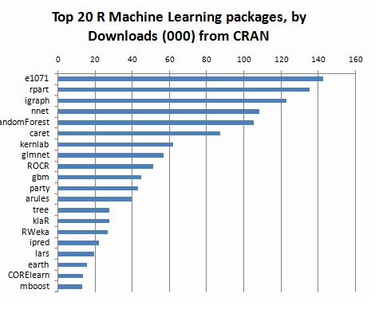
Classification and Prediction with R
R has many packages for classification and prediction tasks (from http://www.kdnuggets.com/2015/06/top-20-r-machine-learning-packages.html ) :

Slide 59
Outline
Introduction to module
Classification and prediction methods
Overview of classification and prediction methods
Classification methods based on analogy
Classification methods based on neural networks
Classification methods based on rules
Classification methods based on probabilities
Classification methods based on statistics
Prediction methods
Evaluation of prediction performance
Evaluation schemes
Combining feature selection and prediction
Prediction workflow
Classification and prediction with R
R scripts for prediction from gene expressions

Slide 60
R Scripts for Prediction from Gene Expressions
Watch the video
Start Jupyter notebook from the provided link

